Slide 1
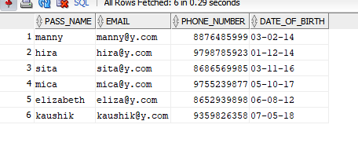
DATETIME FUNCTION

Slide 2

ADD_MONTHS

Slide 3

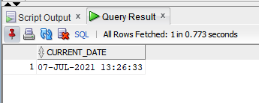
CURRENT_DATE

Slide 4

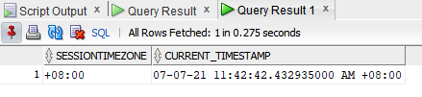
CURRENT_TIMESTAMP

Slide 5

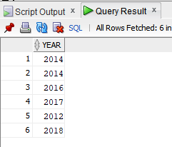
EXTRACT

Slide 6

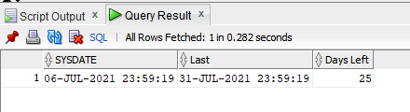
LAST_DAY

Slide 7

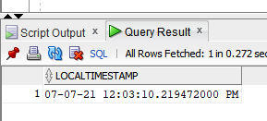
LOCALTIMESTAMP

Slide 8
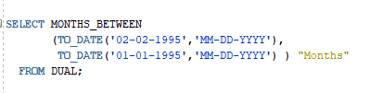
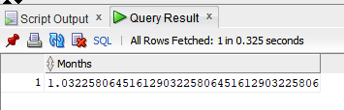
MONTHS_BETWEEN

Slide 9

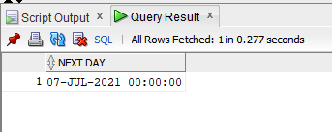
NEXT_DAY

Slide 10


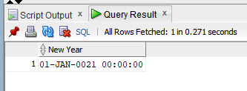
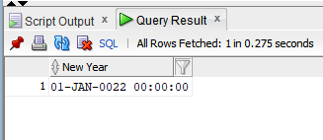
ROUND

Slide 11

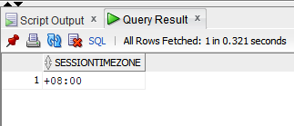
SESSIONTIMEZONE

Slide 12
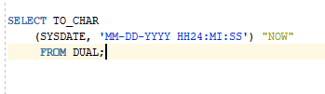
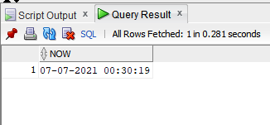
SYSDATE

Slide 13

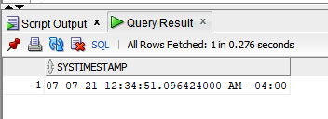
SYSTIMESTAMP

Slide 14
THANK YOU!

